Slide 1
Conditionals
If statement | If-else Statement | Comparison Operators | Nested statements and else-if statement
Notes:
Welcome to our lecture on conditional statements. In this lecture we will go through if statements, if-else statements, comparison operators, and nested and else-if statements. Let’s start our lecture.

Slide 2
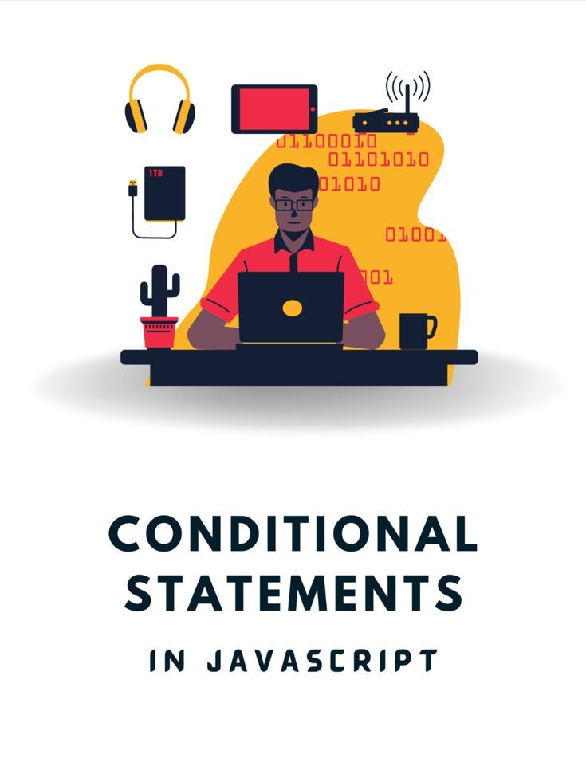
If Statements
Definition: An if statement executes a group of statements only when a specified condition is true.
Syntax: The group of statements is enclosed in braces { }.
Best Practice: Indent the statements inside the braces consistently, such as using 3 spaces for clarity and readability.
Notes:
An if statement allows conditional execution of code. It checks a specified condition and runs a group of statements only if the condition is true. These statements are enclosed in braces to group them together. For clarity and readability, it is a best practice to consistently indent the statements inside the braces, such as using three spaces, to improve the structure of the code.

Slide 3
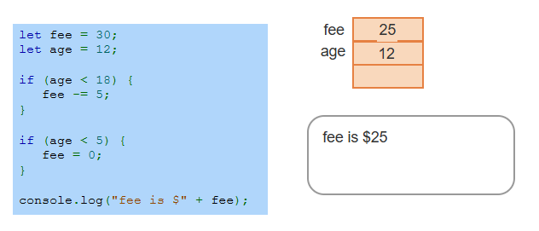
Example
Notes:
This example uses if statements to calculate a fee based on age. The initial fee is 30. If the age is less than 18, 5 is subtracted from the fee. If the age is less than 5, the fee is set to 0. In this case, the age is 12, so the first condition reduces the fee to 25. The second condition does not apply since age is not less than 5. The final output is fee is 25 dollar.

Slide 4
If-else Statement
Definition: An if-else statement evaluates a condition and executes one block of statements if the condition is true.
Alternative Execution: If the condition is false, a different block of statements is executed.
Structure: The two blocks of statements are clearly separated, ensuring one executes based on the condition's outcome.
Notes:
The if-else statement evaluates a condition and executes one block of code if the condition is true. If the condition is false, an alternative block of code is executed. This structure ensures that only one block of code runs depending on the outcome of the condition. It is useful for making decisions where different actions are required based on specific conditions.

Slide 5
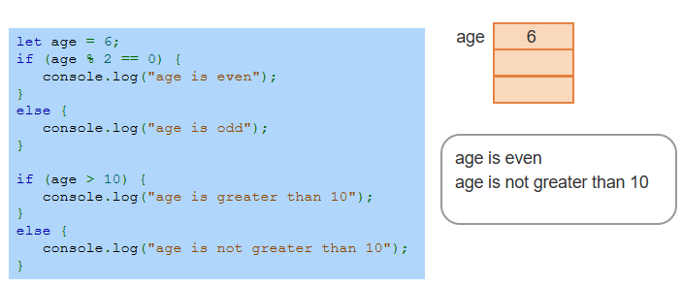
Example
Notes:
This example uses if-else statements to evaluate conditions. The first condition checks if age is even by using the modulus operator. Since 6 is even, it logs age is even. The second condition checks if age is greater than 10. Since 6 is not greater than 10, the else block runs, logging age is not greater than 10. This demonstrates how if-else handles decision-making based on conditions.

Slide 6
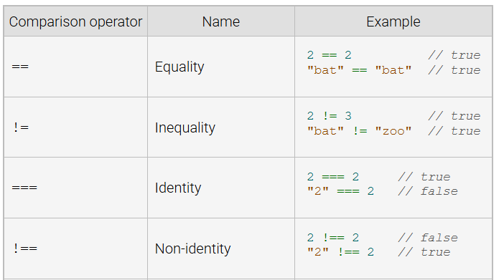
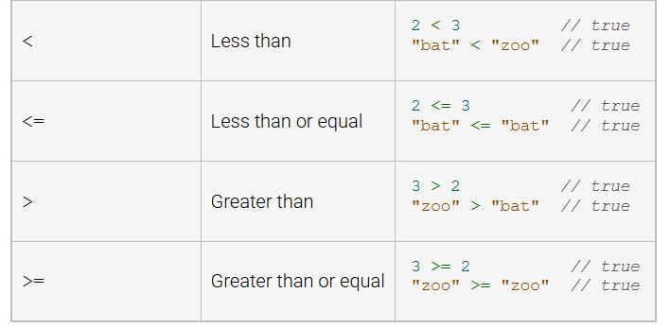
Comparison Operators
Comparison Operators: Used in if and if-else statements to compare two operands, returning a Boolean value (true or false).
Notes:
Comparison operators are used in if and if-else statements to compare two values, returning true or false. Common operators include equality, inequality, identity, and non-identity. Relational operators like less than, greater than, and their equal variants compare numerical or string values. These operators are essential for making decisions in conditional statements.

Slide 7
Nested and If-else Statement
Nested Statements: If and else blocks can contain other valid statements, including another if or if-else statement.
Definition: An if or if-else statement within another if or if-else statement is referred to as a nested statement.
Usage: Nested statements allow for more complex decision-making by evaluating multiple conditions hierarchically.
Notes:
Next comes nested statements which occur when an if or if-else statement is placed inside another if or else block. This allows for more complex decision-making by checking multiple conditions in a hierarchical order. For example, one condition can lead to another set of conditions. Nested statements are useful for scenarios requiring detailed evaluations but should be kept readable to avoid confusion.

Slide 8
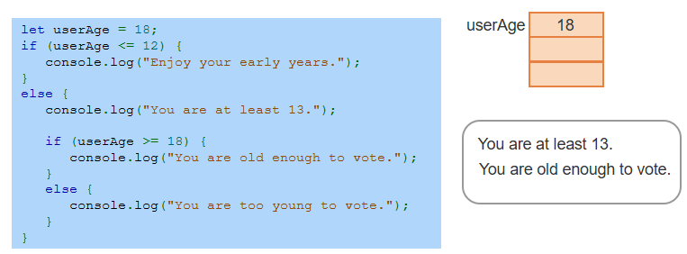
Example
Notes:
This example demonstrates nested if-else statements. The outer condition checks if user Age is less than or equal to 12. If true, it logs Enjoy your early years. Otherwise, it logs You are at least 13 and evaluates the inner condition. The inner condition checks if user Age is at least 18. If true, it logs You are old enough to vote. If false, it logs You are too young to vote. The final output reflects the given age.

Slide 9
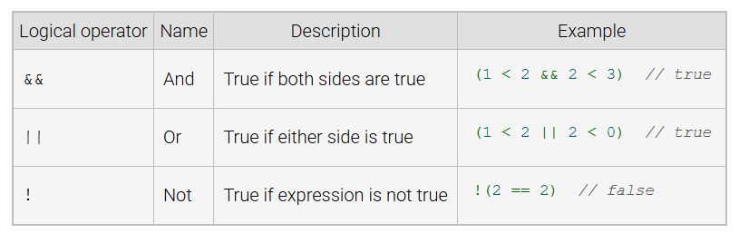
Logical Operators
Notes:
Logical operators are used to combine or invert conditions in JavaScript. The AND operator returns true if both conditions are true, as shown in the example 1 less than 2 and 2 less than 3. The OR operator returns true if either condition is true, like 1 less than 2 OR 2 less than 0. The NOT operator inverts a condition, returning true if the condition is false, as seen in 2 is not equal to 2, which returns false. Thanks for watching the lecture.

